Slide 1
SECURE DATA HIDING IN IMAGES USING STEGANOGRAPHY
CAPSTONE PROJECT
Presented By: Parrisha Jain
Student Name : Parrisha Jain
College Name : Netaji Subhas University of Technology
Department: Mechanical Engineering

Slide 2
OUTLINE
Problem Statement
Technology used
Wow factor
End users
Result
Conclusion
Git-hub Link
Future scope

Slide 3
PROBLEM STATEMENT
In today's digital world, data security and privacy are major concerns. Traditional encryption methods secure data but make it obvious that encryption is in use, attracting potential attackers. This project aims to develop a method to securely hide confidential messages within images using steganography, making the data inconspicuous while ensuring it remains protected. By embedding secret messages into image pixels, this approach allows safe and covert communication, reducing the risk of detection.

Slide 4
TECHNOLOGY USED
Libraries:
OpenCV (cv2) – For image processing
os – For file handling and opening images
Platforms:
Compatible with Windows, macOS, and Linux
Python as the primary programming language

Slide 5
WOW FACTORS
RGB Channel Utilization: Instead of modifying only a single channel, the message is distributed across all three RGB channels, making detection more difficult.
Passcode Protection: The decryption process requires a password, adding an extra layer of security.
Minimal Image Distortion: The changes to pixel values are subtle, making it challenging to detect any modifications visually.
Custom Encoding Scheme: The project implements a unique character encoding approach, making decryption impossible without the correct logic.
Cross-Platform Support: The solution works across multiple operating systems with minimal dependency.

Slide 6
END USERS
Cybersecurity Professionals – For secure communication and confidential data storage.
Journalists & Activists – To safely transmit sensitive information under strict surveillance.
Government and Intelligence Agencies – For covert data transmission in secure operations.
Businesses & Enterprises – To protect sensitive corporate information from cyber threats.
Individuals Concerned About Privacy – For personal use to keep data hidden from unauthorized access.

Slide 7

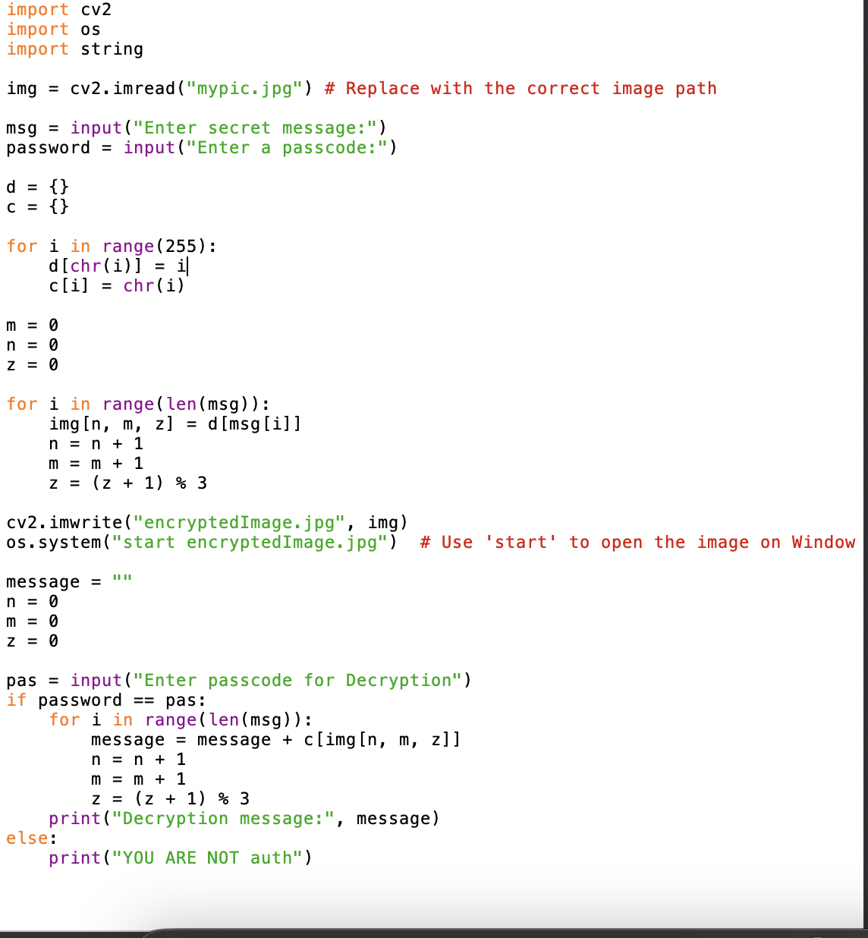
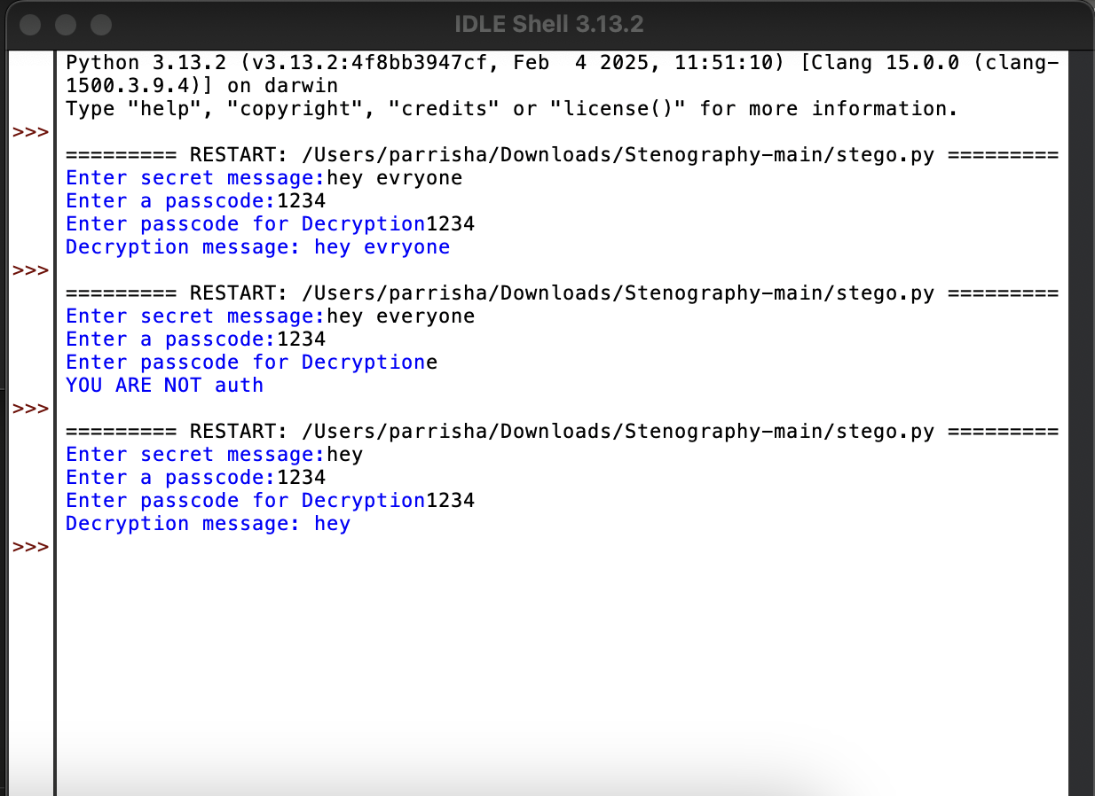
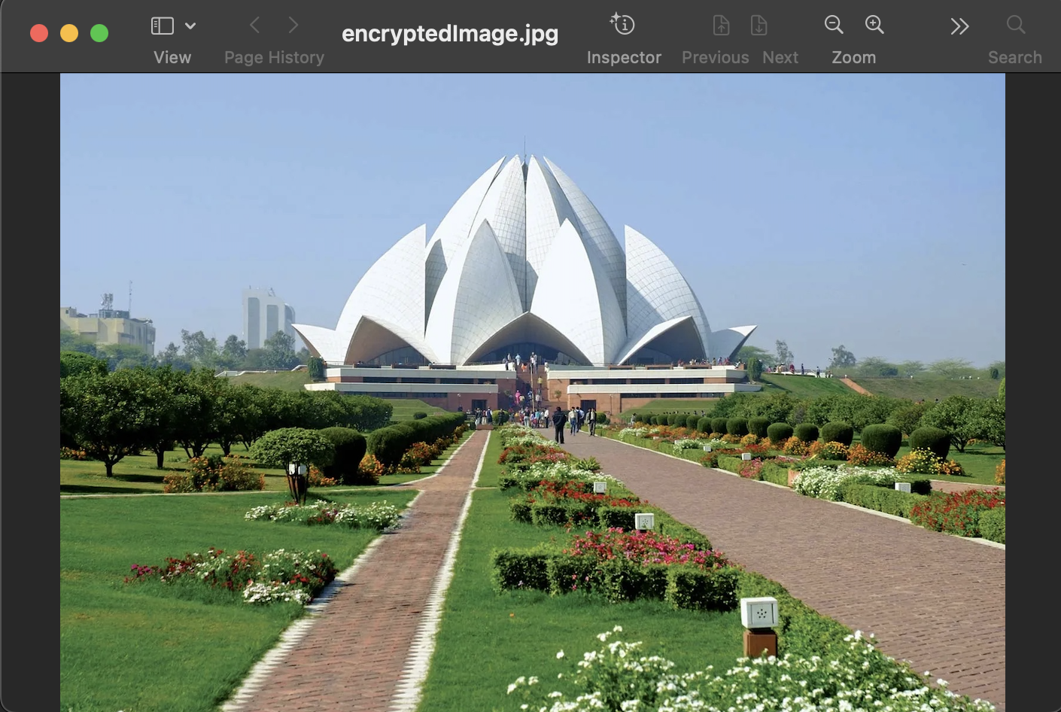
RESULTS

Slide 8
CONCLUSION
This project effectively addresses the problem of secure data transmission by leveraging steganography to conceal messages within images. Unlike traditional encryption, which can alert attackers to the presence of sensitive data, this method allows for inconspicuous communication while maintaining a high level of security. The use of password protection further strengthens the confidentiality of the hidden message. With its ease of use and adaptability, this project provides a practical and robust solution for secure information exchange in a digital environment.

Slide 9
GITHUB LINK
https://github.com/Parrisha-J/aicte-project.git

Slide 10
THANK YOU

